Slide 1
SAP EWM EXTENDED WAREHOUSE MANAGEMENT TRAINING
AnubhavTrainings.com
www.anubhavtrainings.com

Slide 2

SAP EWM TRAINING
BY:-
Mr. Bijoy
www.anubhavtrainings.com
Notes:
https://unsplash.com/photos/uXB-7la5vqA

Slide 3
SAP EWM TRAINING (Day 01)
AnubhavTrainings.com

Slide 4
Overview of SAP EWM
01
SAP WM Overview
Introduction to SAP EWM
04
02
Deployment options
05
Difference between EWM & WM
03
Embedded & De-centralized EWM

Slide 5
ERP- EWM integration
Define ERP
warehouse number
Define EWM
warehouse number
01
04
01
Assign warehouse plant st location
Content
Set up distribution model
02
05
03
Configure EWM specific parameters
Assign ERP – EWM warehouse number
06
08
Assigning bp &
supply chain unit
Define stock types
in EWM
Define availability group & maintain interface table
09
07

Slide 6
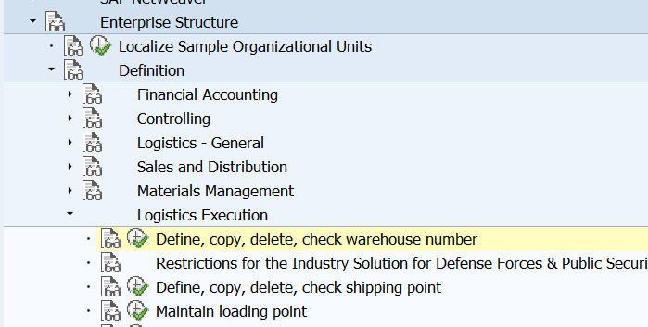
Define Erp Warehouse Number
(Note – Always prefer to create new entry for warehouse no. creation)

Slide 7
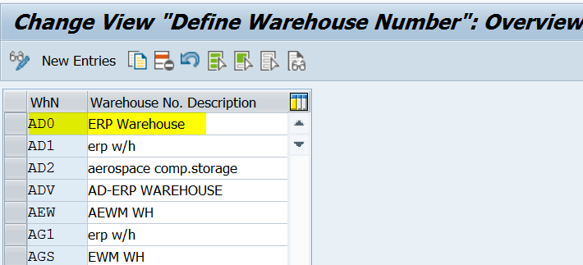
Change View Define Warehouse Number Overview
www.anubhavtrainings.com

Slide 8
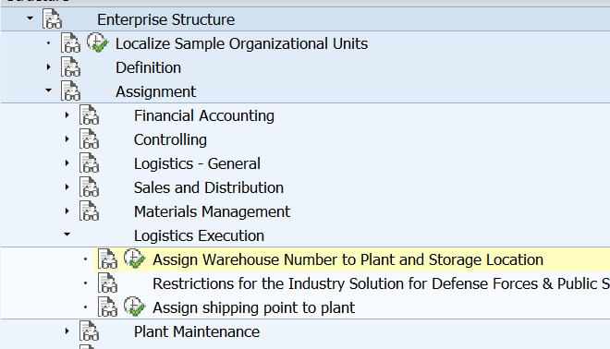
Assign Warehouse Plant St Location
ROD1 – Inbound for EWM
AFS1 – Outbound for EWM
www.anubhavtrainings.com

Slide 9
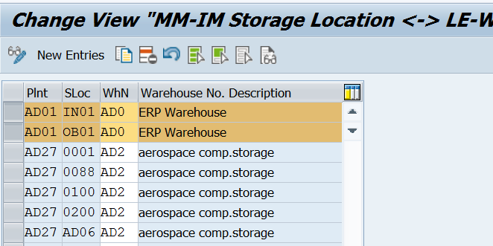
Change View MM-IM Storage Location
www.anubhavtrainings.com

Slide 10
Configure Ewm Specific Parameters
Logistics Execution
Extended Warehouse Management Integration
Basic Setup of Connectivity
Configure SAP EWM Specific Parameters
Ext. WM : E (ERP with extended warehouse management) comm. WM: Q (queued and serialized asynchronous RFC) dist. Mode: distribution immediately at document creation

Slide 11
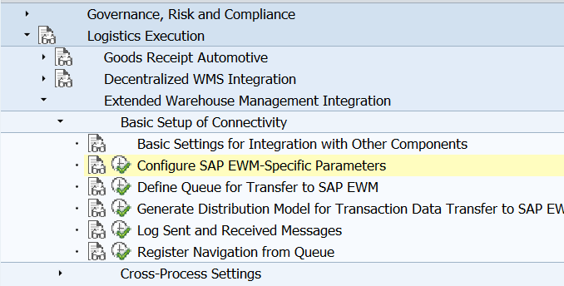
Configure Ewm Specific Parameters
www.anubhavtrainings.com

Slide 12
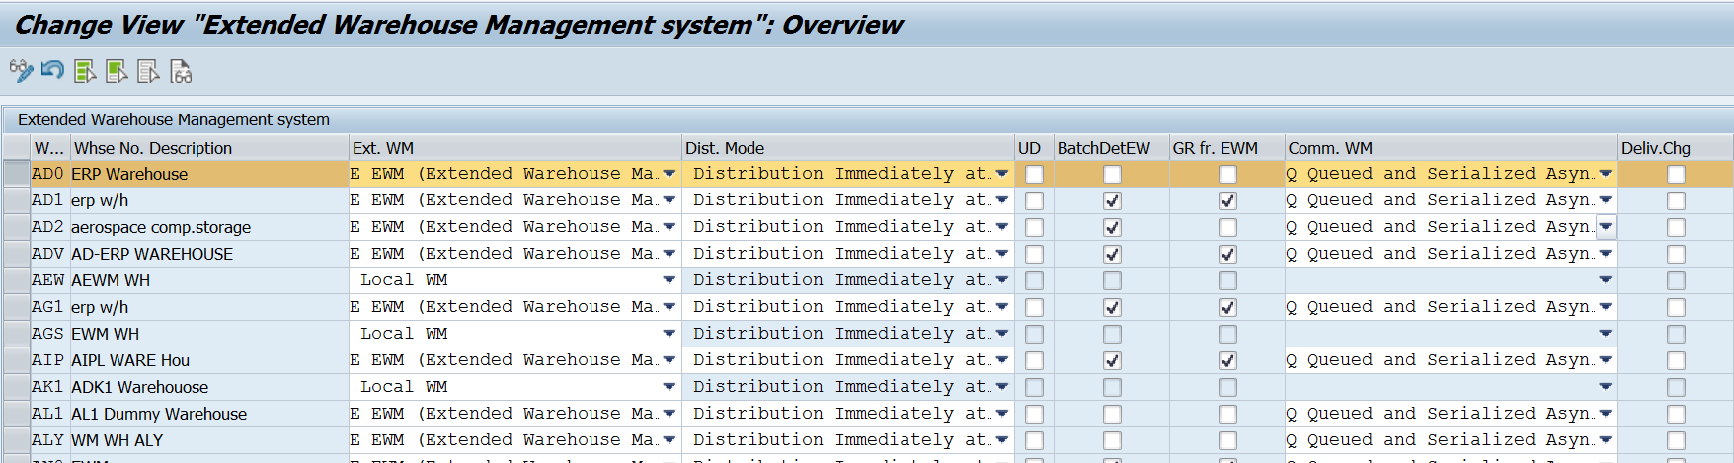
Change View external warehouse system
www.anubhavtrainings.com

Slide 13
Distribution Mode for the Delivery
You use this setting to specify the time when an inbound/outbound delivery is
distributed to the decentralized WMS. The setting is valid for all inbound/
outbound deliveries that are processed in the relevant warehouse number.
Communication with the Warehouse System
The communication between SAP S/4HANA and the SAP EWM system can be
based on different communication methods such as qRFC and SOA.
www.anubhavtrainings.com

Slide 14
Define Ewm Warehouse Number
www.anubhavtrainings.com

Slide 15
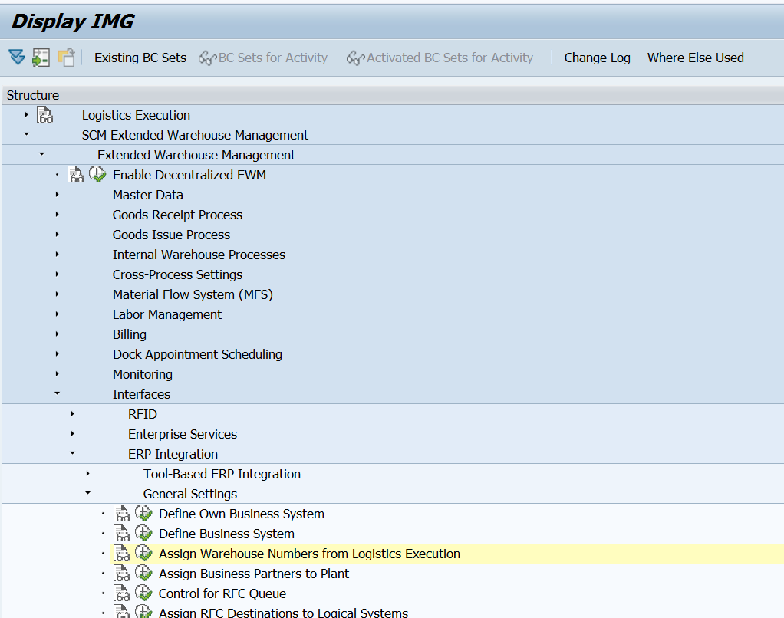
Assign Erp – Ewm Warehouse Number
www.anubhavtrainings.com

Slide 16
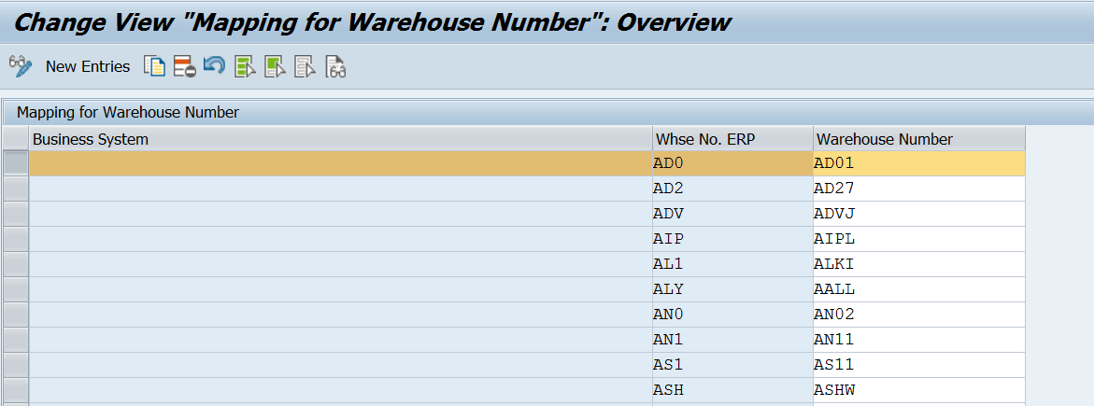
Mapping For Warehouse Number
www.anubhavtrainings.com

Slide 17
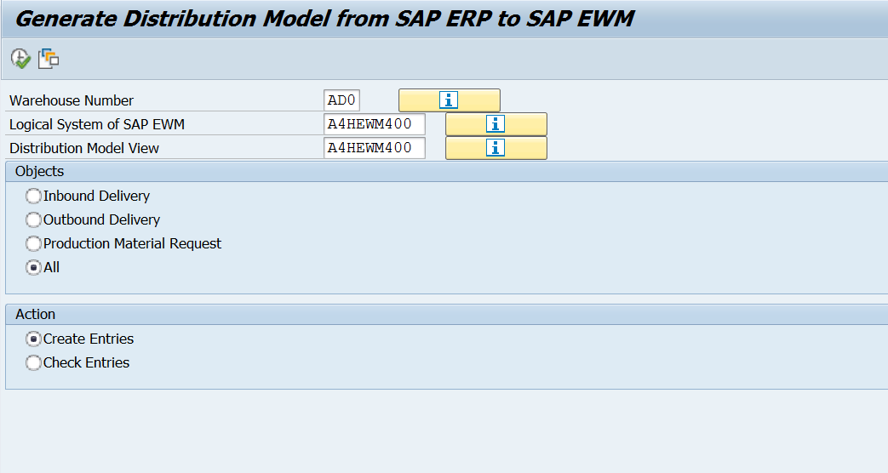
Set Up Distribution Model (Related To Basis Team)
Tcode - /spe/ol19
www.anubhavtrainings.com

Slide 18
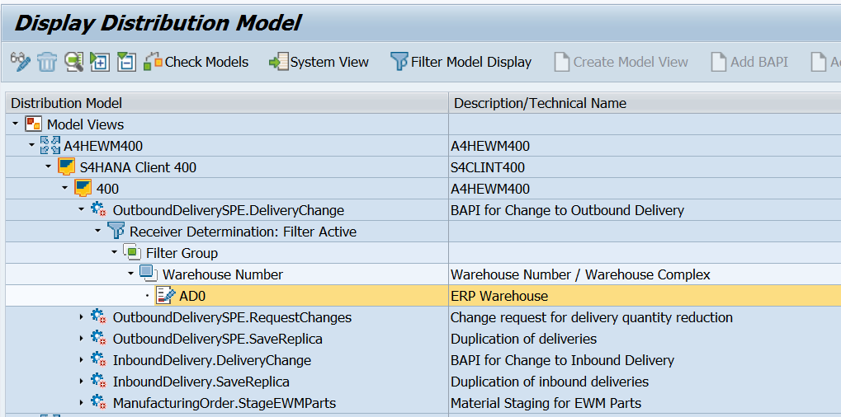
Check distribution model in tcode – bd64 (optional)
www.anubhavtrainings.com

Slide 19
Assigning Bp & Supply Chain Unit
SCU
Custodian:
It is a location with physical address and different business attributes. (Goods receipt office or shipping office)
It is a business partner responsible in terms of stores and manages the stocks in warehouse.
www.anubhavtrainings.com

Slide 20

Party entitled to dispose:
In EWM all products are associated with party entitled to dispose. PED is a plant as a vendor/bp in ERP and the products identified in EWM along PED.
Owner: Owner is a business partner in EWM. If any consignment stock stores in EWM warehouse owner and PED both are different, otherwise both are same.
www.anubhavtrainings.com

Slide 21
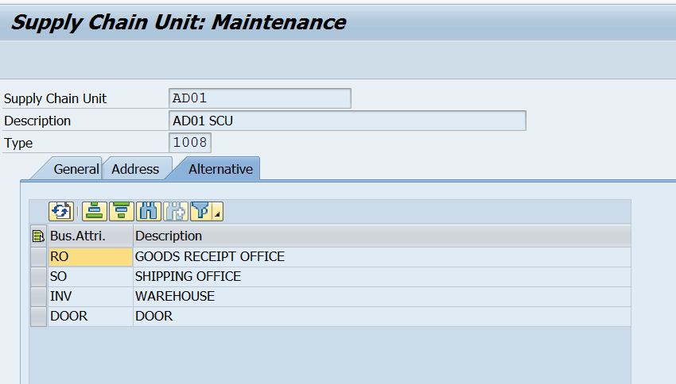
Create SCU by tcode - /scmb/scumain
www.anubhavtrainings.com

Slide 22
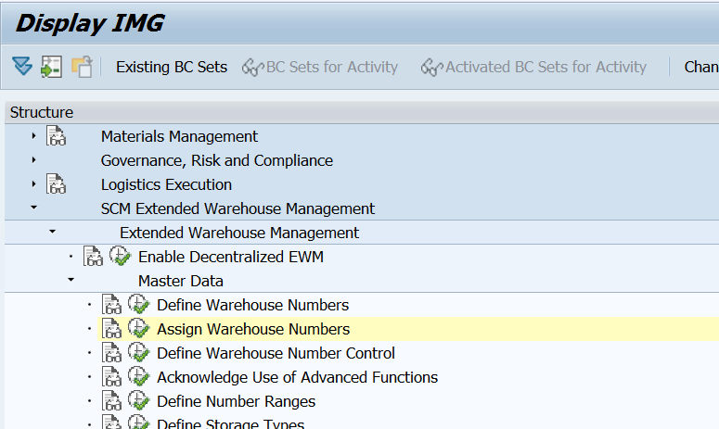
Display Img
www.anubhavtrainings.com

Slide 23
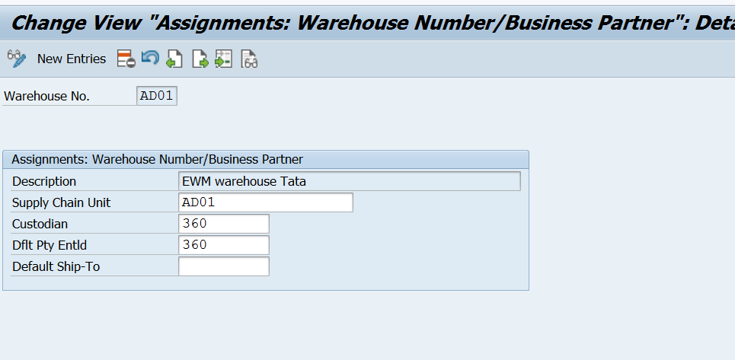
Change View Assignments Warehouse Number
Note – Business partner must be created before this step as Custodian and Default party to entitled.
Maintain BP role Vendor-FLVN01 view with Plant is mandatory!
www.anubhavtrainings.com

Slide 24
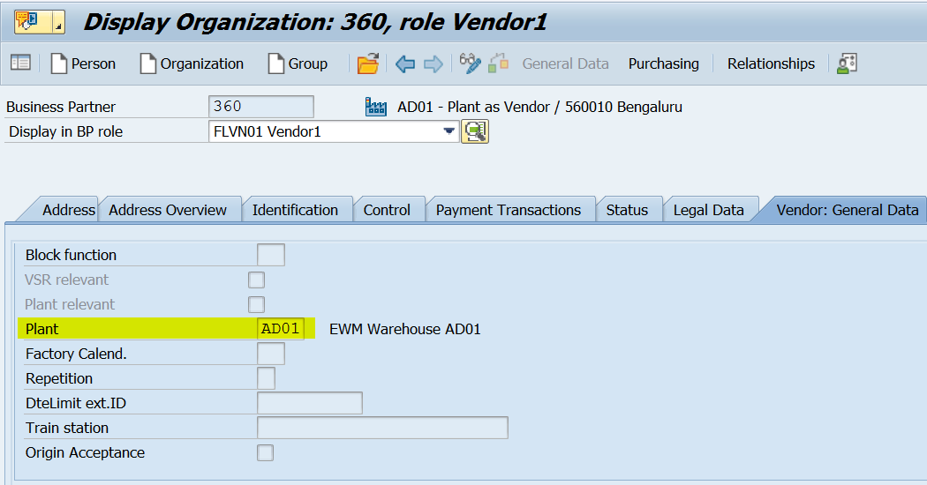
www.anubhavtrainings.com

Slide 25
Define Availability Group & Maintain Interface Table
It is an interface to exchange the stock updates between ERP storage locations and EWM storage types.
EWM system uses availability group to determine the stock types and the storage location of ERP system.
We can have different stock types in EWM for one storage location in ERP. EWM determines ERP sloc with respect to Availability group but the combination should be unique per warehouse.
www.anubhavtrainings.com

Slide 26
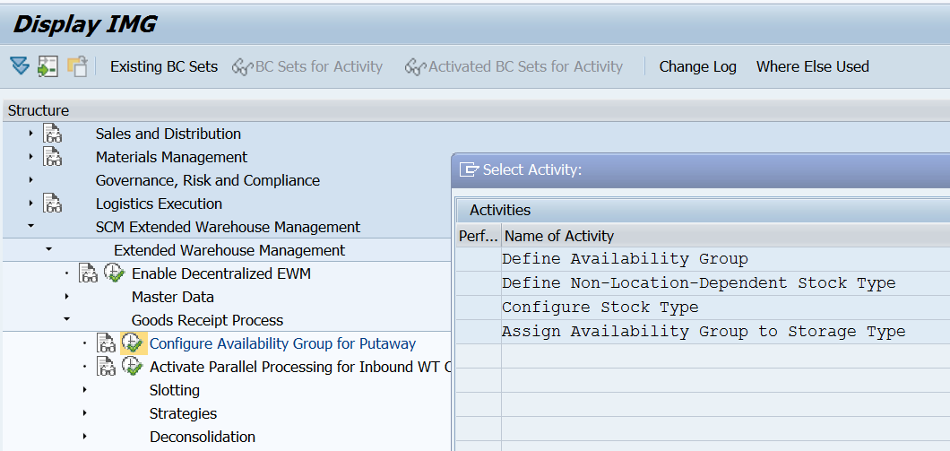
www.anubhavtrainings.com

Slide 27
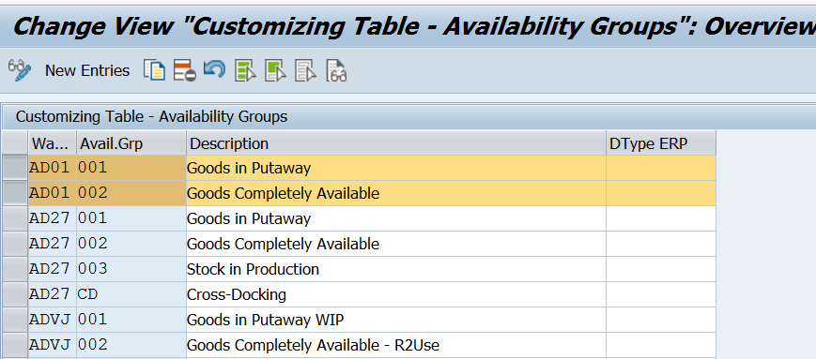
Map Storage Locations from ERP System to EWM. (Interface Table)
www.anubhavtrainings.com

Slide 28
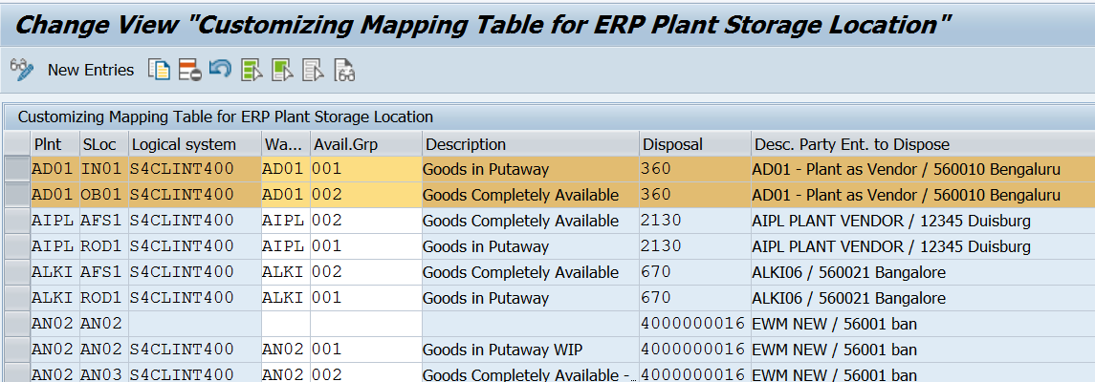
Customizing Mapping Table
www.anubhavtrainings.com

Slide 29
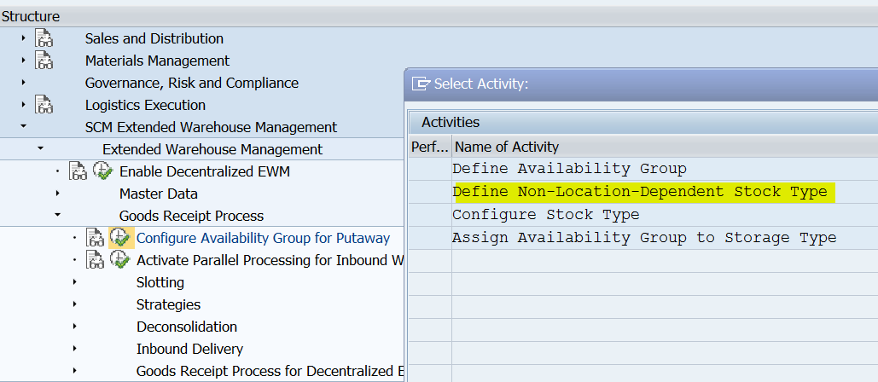
Define Stock Types In Ewm
Under Define Non-Location-Dependent Stock Type, create the following predefined, location-independent stock types corresponding to the stock types in Inventory Management (like FF - Unrestricted-Use Stock)
www.anubhavtrainings.com

Slide 30
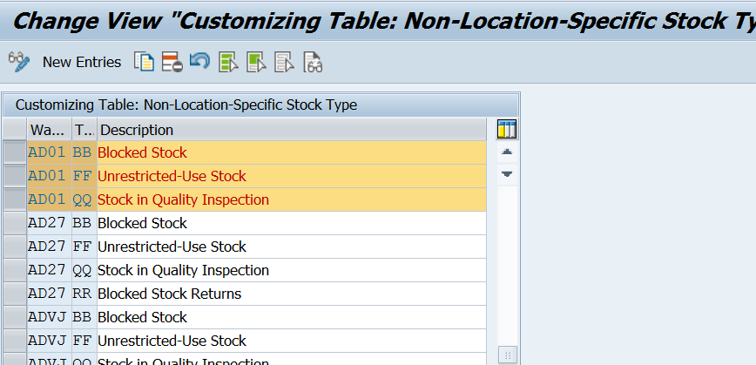
Under Configure Stock Type, create a set of stock types for each availability group. Assign a location-independent stock type and an availability group to each stock type.
www.anubhavtrainings.com

Slide 31
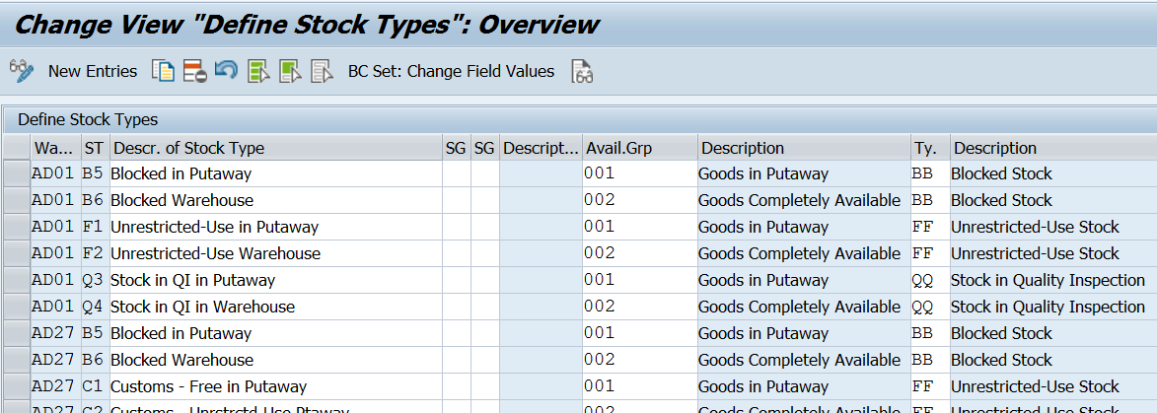
Change View “Define Stock Types “overview
www.anubhavtrainings.com

Slide 32


End of Session 01
www.anubhavtrainings.com

Slide 33

FEEL FREE TO ASK QUESTIONS

Slide 34

Feedback

Slide 35
THANK
YOU

Slide 36

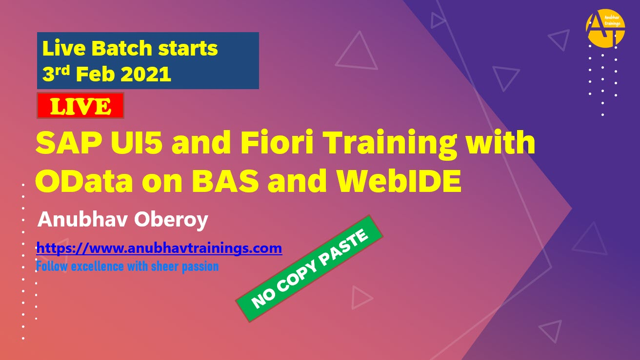

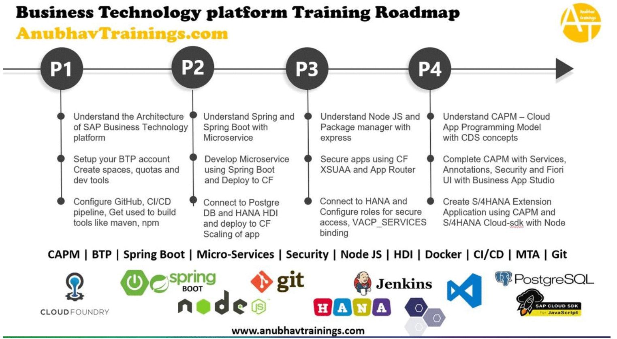
More from AnubhavTrainings.com

Slide 37






We’re committed to empower you to be
#FutureReady
through powerful training solutions.
We build the workforce of the future.
250+
Corporate Clients
30,000+
Learners Trained
25000+
Learners Placed
FREE WEBINARS
Sign up for free webinars with industry experts every fortnight!
Enroll Now!

Slide 38
FREE WEBINARS
Sign up for free webinars with industry experts every fortnight!
Contact us today!
www.anubhavtrainings.com

